Slide 1
ELECTRONIC CIRCUITS – I
(EC8351)
Presented by
PL.NATCHIAMMAI, AP/ECE

Slide 2
SYLLABUS
UNIT I BIASING OF DISCRETE BJT, JFET AND MOSFET 9
BJT– Need for biasing - DC Load Line and Bias Point – DC analysis of Transistor circuits –Various biasing methods of BJT – Bias Circuit Design - Thermal stability - Stability factors - Bias compensation techniques using Diode, thermistor and sensistor – Biasing BJT Switching Circuits- JFET - DC Load Line and Bias Point - Various biasing methods of JFET - JFET Bias Circuit Design - MOSFET Biasing - Biasing FET Switching Circuits.
UNIT II BJT AMPLIFIERS 9
Small Signal Hybrid π equivalent circuit of BJT – Early effect - Analysis of CE, CC and CB amplifiers using Hybrid π equivalent circuits - AC Load Line Analysis- Darlington Amplifier - Bootstrap technique - Cascade, Cascode configurations - Differential amplifier, Basic BJT differential pair – Small signal analysis and CMRR.
UNIT III SINGLE STAGE FET, MOSFET AMPLIFIERS 9
Small Signal Hybrid π equivalent circuit of FET and MOSFET - Analysis of CS, CD and CG amplifiers using Hybrid π equivalent circuits - Basic FET differential pair- BiCMOS circuits.

Slide 3
Cont’d
UNIT- IV FREQUENCY RESPONSE OF AMPLIFIERS 9
Amplifier frequency response – Frequency response of transistor amplifiers with circuit capacitors– BJT frequency response – short circuit current gain - cut off frequency – fα, fβ and unity gain bandwidth – Miller effect - frequency response of FET - High frequency analysis of CE and MOSFET CS amplifier - Transistor Switching Times.
UNIT- V POWER SUPPLIES AND ELECTRONIC DEVICE TESTING 9
Linear mode power supply - Rectifiers - Filters - Half-Wave Rectifier Power Supply - Full-Wave Rectifier Power Supply - Voltage regulators: Voltage regulation - Linear series, shunt and switching Voltage Regulators - Over voltage protection - BJT and MOSFET – Switched mode power supply (SMPS) - Power Supply Performance and Testing - Troubleshooting and Fault Analysis, Design of Regulated DC Power Supply.

Slide 4
Cont’d
TEXT BOOKS:
1. Donald. A. Neamen, Electronic Circuits Analysis and
Design, 3rd Edition, Mc Graw Hill Education (India)
Private Ltd., 2010. (Unit I-IV)
2. Robert L. Boylestad and Louis Nasheresky,
―Electronic Devices and Circuit Theory‖, 11th
Edition, Pearson Education, 2013. (Unit V)
Local author: U.A. Bakshi & A.P.Godse

Slide 5
CONTENTS
What are Electronic Circuits?
Biasing
Need for Biasing
DC load line
Bias Point or Operating Point or Q-Point
Factors affecting Q-point.
Bias Stability or Stabilization
Stability factor

Slide 6
Electronic Circuits
Circuits:
Many components are connected together either in series or parallel with respect to ground.
Electronic Circuits:
An electronic circuit is composed of individual electronic components, such as resistors, transistors, capacitors, inductors and diodes, connected by conductive wires or traces through which electric current can flow.

Slide 7
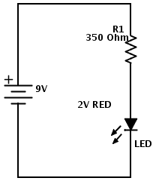
Example of electronic circuits

Slide 8
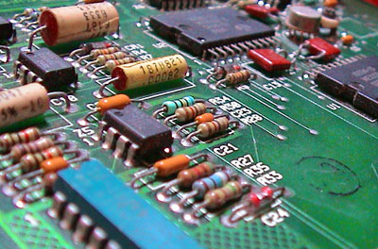

Slide 9
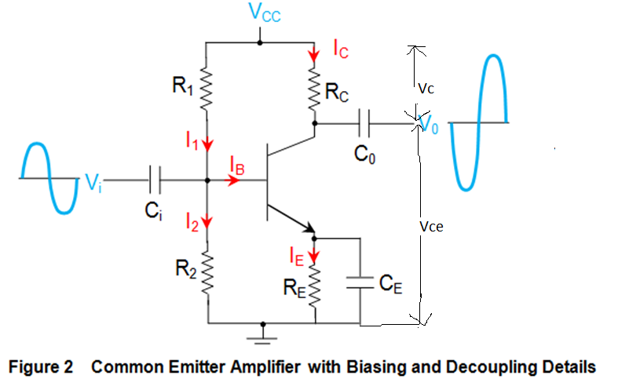
Transistor as an Amplifier or
CE Amplifier

Slide 10
Operation of CE Amplifier
Definition for an amplifier:
Weak signal is converted into strong signal is known as an amplifier.
Construction:
Here resistors R1, R2, Rc provides biasing to transistor by using supply voltage Vcc..
Ci is input coupling capacitor, it blocks dc signal and allows only ac signal.
C2 is output coupling capacitor is used to connect the o/p of first stage to input of next stage and o/p is connected to load RL(load resistor) via C2.
Re (emitter resistor)and Ce (emitter capacitor) provides loss of amplification and provides thermal stability

Slide 11
Cont’d
Operation:
When Vin is positive going (+voltage):
When Vi increases in +ve direction, Vbe increases and it increases Ib & Ic, thereby increasing the voltage drop across Rc. So it reduces the Vce. Therefore, o/p goes in –ve direction when Vi increases in +ve direction.
When Vin is negative going (-voltage):
When Vi goes in -ve direction, Vbe decreases and it decreases Ib & Ic, thereby decreasing the voltage drop across Rc. So it increases the Vce. Therefore, o/p goes in +ve direction when Vi goes in -ve direction. Thus we get an amplified output of input signal with 180° phase shift.

Slide 12
BIASING
DEFINITION:
Giving or applying dc voltages to the transistor circuits in order to operate the transistor in the desired region is known as biasing

Slide 13
Need for Biasing
Operation of Region | Emitter base Junction | Collector Base Junction | Applications
Cut off | Reverse Biased | Reverse Biased | Switch(off)
Active | Forward Biased | Reverse Biased | Amplifier
Saturation | Forward Biased | Forward Biased | Switch(on)

Slide 14
Cont’d
In order to operate the transistor in the desired region and depends on applications we have to apply external dc voltages of correct polarity and magnitude of the two junctions of the transistor. This is nothing but called as biasing.
In transistors amplifier circuits, output signal power is always greater than input signal power. This is called as amplification. It is achieved by applying proper biasing to the transistor

Slide 15
Cont’d
So we can conclude that:
Need for biasing in BJT circuits:
In order to operate the transistor in the desired region.(i.e. Active or cutoff or saturation)
To ensure proper amplification without
any distortion.

Slide 16
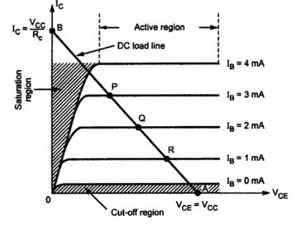
DC load line

Slide 17
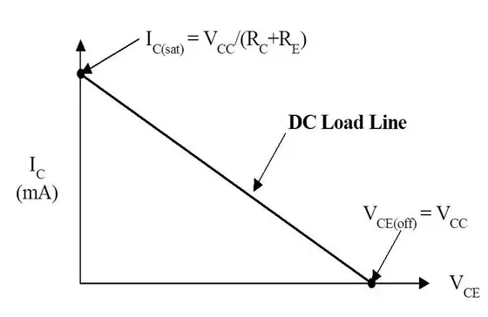
DC load line

Slide 18
Cont’d
Definition for dc load line:
It is the line drawn on the characteristics of a transistor circuit which gives the value of Ic and Vce corresponding to zero input signal(i.e. without input signal).
Only dc conditions are considered, it has named dc load line.

Slide 19
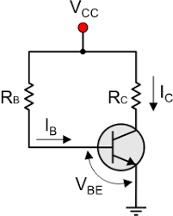
Example circuit to draw dc load line

Slide 20
Cont’d
To find Vce:
Apply KVL(Kirchoff”s Votage Law) to o/p
side in above circuit,
Potential rise = Potential drop.
Vcc = IcRc + Vce ------eq.1
Vce = Vcc – IcRc------eq.2
To draw dc load line, we need two points(A & B), it can be calculated as follows:
When Ic = 0, then Vce is
From eq.2, Vce = Vcc--→this gives the
first point A on x-axis

Slide 21
Cont’d
(ii) When Vce = 0, then Ic is
From eq.2, Vce = Vcc – IcRc
0 = Vcc – Ic Rc
Vcc = IcRc.
Ic = Vcc/Rc----→ this gives
the second point B on y-
axis

Slide 22
Problems in DC load line

Slide 23
Cont’d
1.For the circuit shown above, draw dc load line if Rc = 2.5K and Vcc = 12.5v.
I.Given datas:
    Rc = 2.5K
    Vcc = 12.5v
II.To find:
To draw dc load line, we have to find,
Vce = ?
Ic = ?

Slide 24
Cont’d
III. Solution:
W.K.T. , Vce = Vcc
Vce = 12.5V
& Ic = Vcc/Rc
= 12.5V/2.5K
= 12.5/2.5 x 1000
Ic = 5mA
Result: Vce = 12.5V, Ic = 5mA

Slide 25
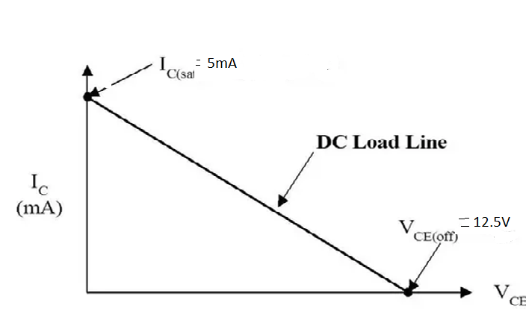
DC load line for the problem 1

Slide 26
Cont’d
Problem 2. Home work.
2.For the circuit shown below, draw dc load line if Rc = 9.1K and Vcc = 24v.

Slide 27
Operating Point or Q-point or Bias Point
Definition:
The zero signal values of Ic and Vce are known as the operating point.
Why it is called as Q- point?
It is also called Q(Quiescent)- point because it is the point where the transistor is silent.(i.e.in the absence of input signal).

Slide 28
Cont’d
The operating point must be stable for proper operation of the transistor.
It should be near saturation, cut-off or at the active region(center) of the dc load line as shown in figure below based on applications.
The zero signal values are :
    Vce = OC volts
    Ic = OD mA

Slide 29
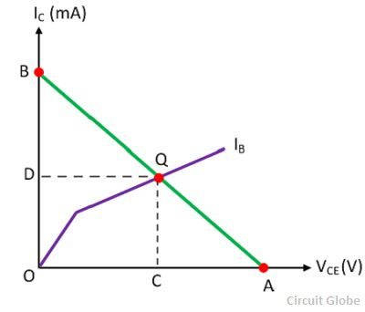
Graph indicating Q-point

Slide 30
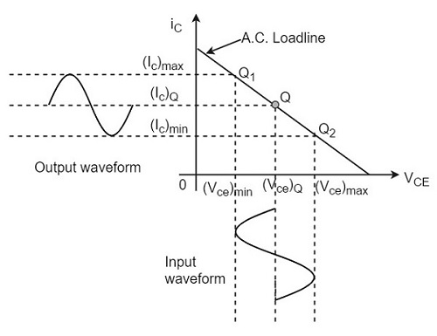
Selection of Q-point

Slide 31
Near active region
The above figure shows Q-point is in center of dc load line.
So transistor will be operated in the active region and it can be used as an amplifier.
In figure, input and output waveforms are out of phase i.e. 180 phase shift.

Slide 32
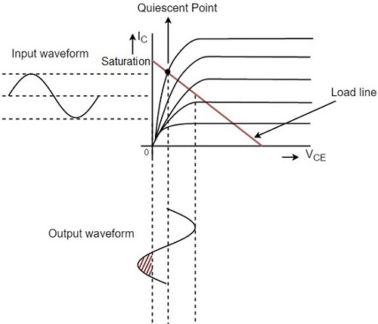
Near saturation region

Slide 33
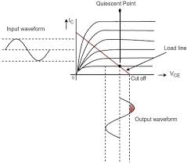
Near cut-off region

Slide 34
Factors affecting Q-point
Temperature Dependence
Thermal runaway
Variation of hfe within manufacturers tolerance

Slide 35
Temperature Dependence
Change in temperature affect the following parameters of the transistor:
Ico = Collector current or reverse saturation current (emitter open) or collector leakage current I_{CBO}
I_{C} = βI_{B} + I_{CBO}
V_{BE = Base emitter voltage}
β = Current Amplification factor for CE
transistor.

Slide 36
Thermal run away
The self destruction of an unstabilized transistor is known as thermal run away.
To avoid this, operating point must be stabilized.

Slide 37
BIAS STABILITY OR STABILIZATION
Need:
Biasing circuits are used to fix the Q-point at the center of the active region
Care should be taken while designing the biasing circuits.
So designing the biasing circuit to stabilize the Q-point is known as bias stability.

Slide 38
Cont’d
Stabilization:
The process of making operating point independent of temperature changes or variation in transistor parameters is known as stabilization

Slide 39
Techniques used for bias stabilization
Stabilization techniques.
Uses the resistive biasing circuits which allow Ib to vary so as to keep Ic relatively constant with variations in Ico, Vbe and β
Compensation techniques.
Uses the temperature sensitive devices such as diodes, transistors, thermistors etc.,

Slide 40
Types of Stabilization techniques
Fixed bias or Base bias
2. Collector to base bias or Feedback
method
3. Voltage divider bias or self bias

Slide 41
Types of Compensation techniques
Diode compensation techniques
2. Thermistor compensation techniques
3. Sensistor compensation techniques

Slide 42
Stability Factor(S)
Definition:
It is defined as the rate of change of collector current Ic with respect to reverse saturation current I_{co} keeping β and V_{BE} constant.
S = d I_{C} /d I_{Co} by keeping β and V_{BE}
constant

Slide 43
Cont’d
Three stability factors
1. S = d I_{C} /d I_{Co} by keeping β and V_{BE}
constant
2. S’ = d I_{C} /d V_{BE} by keeping β and I_{Co}
constant
3. S’’ = d I_{C} /d β by keeping and V_{BE} and I_{Co}
constant

Slide 44
Cont’d
Bias circuits gives various stability factors
Stability factor indicates the degree of stability provided by these circuits.

Slide 45
THANK YOU

